Slide 1




NEXT GEN EMPLOYABILITY PROGRAM
Creating a future-ready workforce
Team Members
College Name
Student Name : Gowtham.R
Student ID : 623521104017
6235 - AVS College of Technology

Slide 2

CAPSTONE PROJECT SHOWCASE
Project Title
Building Bus Reservation System using Python and Django
Abstract | Problem Statement | Project Overview | Proposed Solution | Technology Used | Modelling & Results | Conclusion

Slide 3
Abstract
Reservation process allows users to select seats, make payments securely through integrated payment gateways, and receive email notifications for booking confirmations and updates.
Administrators have access to a dashboard for monitoring bookings, managing buses/routes, viewing sales reports, and performing administrative tasks efficiently.
Designed for scalability, flexibility, and easy customization to meet evolving needs of bus operators and passengers.
Leveraging Python and Django for robustness, reliability, and seamless user experience.
Source :

Slide 4
Problem Statement
Streamlines the booking process for passengers.
Provides accurate and real-time information about available buses and seats.
Seamlessly integrates payments for a hassle-free experience.
Offers robust reservation management features to prevent overbooking and conflicts.
Empowers administrators with effective tools for bus and route management.
Source :

Slide 5
Project Overview
The Bus Reservation System (BRS) is a web-based application designed to streamline the process of booking bus tickets and managing reservations. Developed using Python and the Django framework, the BRS aims to provide a user-friendly platform for both passengers and bus operators.
Python: Backend development and business logic implementation.
Django: Web framework for rapid development and MVC architecture.
HTML/CSS/JavaScript: Frontend development for designing user interfaces and adding interactivity.
SQLite/PostgreSQL: Database management for storing application data.
Source :

Slide 6
Proposed Solution
Develop a comprehensive Bus Reservation System (BRS) using Python and Django framework to streamline the booking process and enhance reservation management.
Key Components:
User Management
Bus and Route Management
Seat Reservation
Payment Integration
Reservation Management
Admin Dashboard
Source :

Slide 7


Technology Used
Front-end
Back-end
Source :

Slide 8
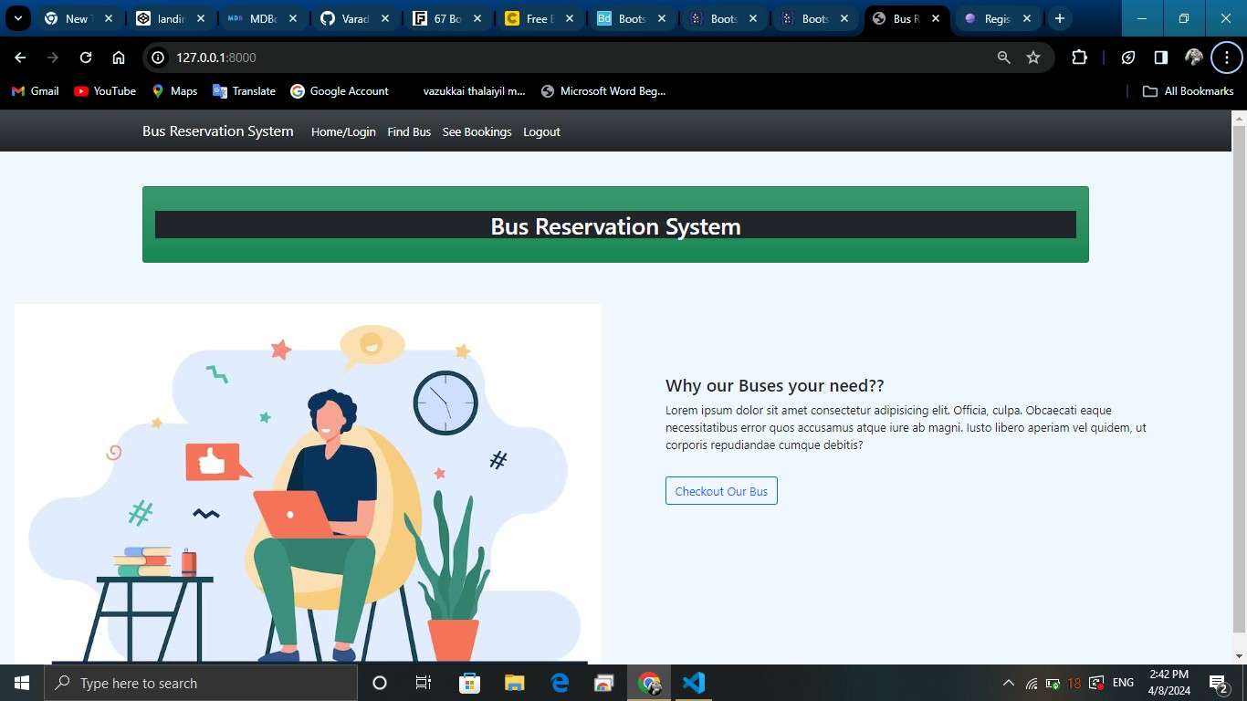
Modelling & Results
Source :

Slide 9
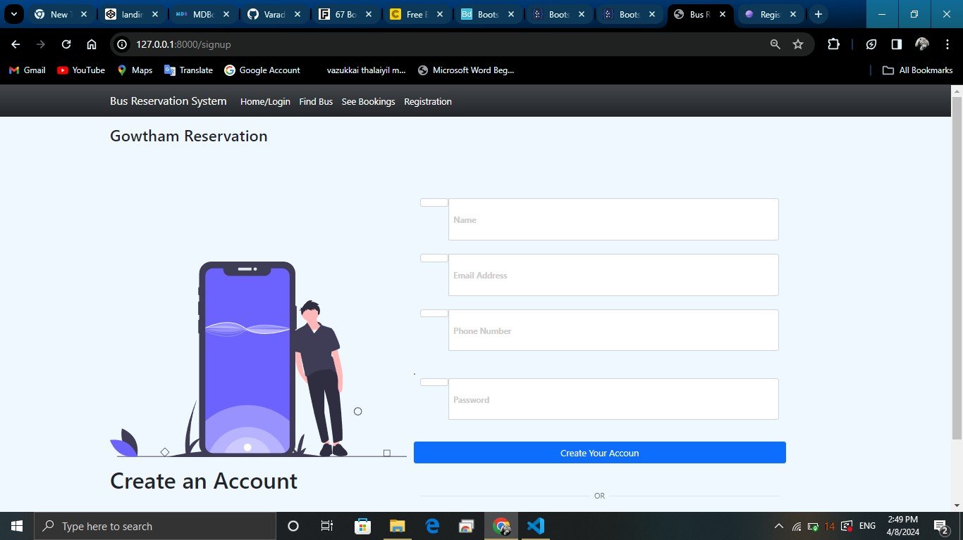
Registration

Slide 10
HOME PAGE

Slide 11
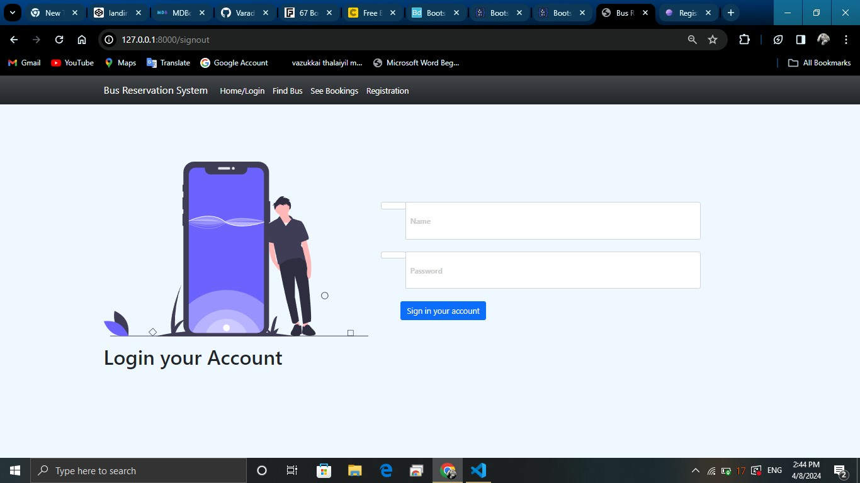
LOGIN PAGE

Slide 12
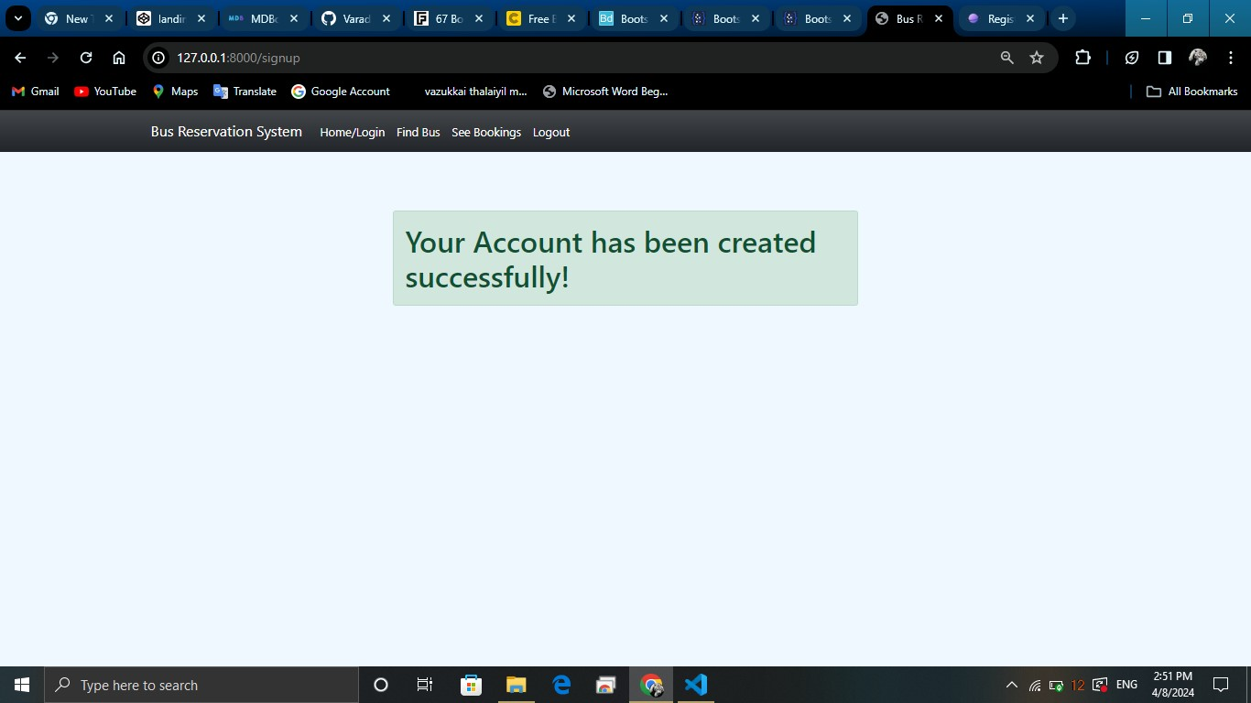
THANKS PAGE

Slide 13
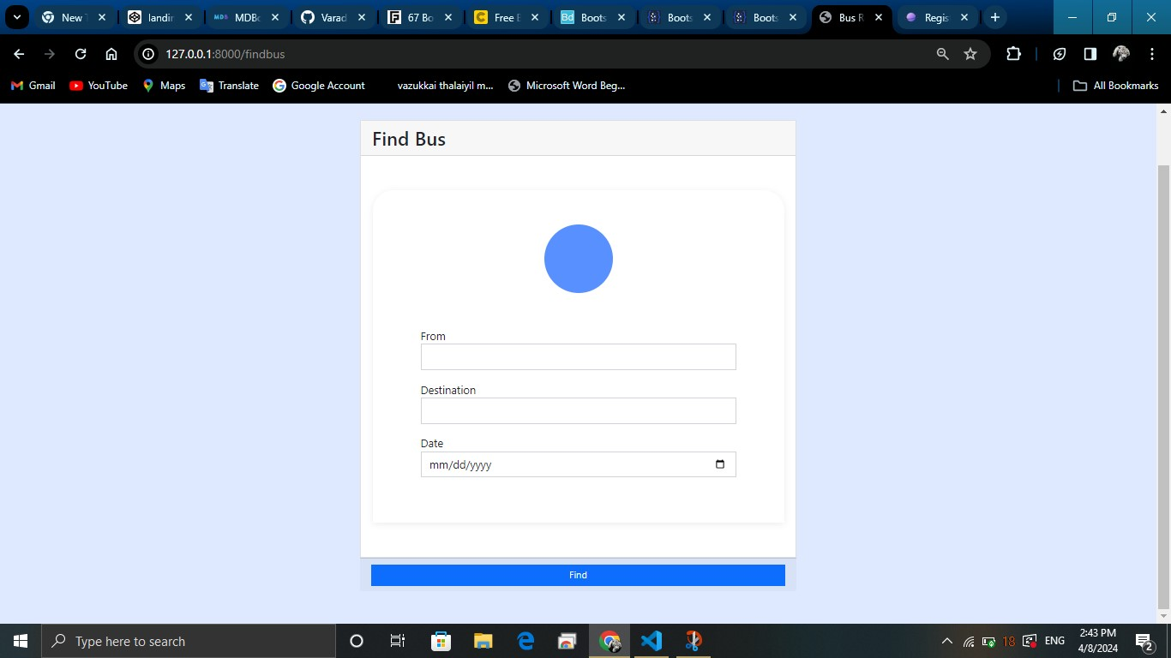
Find Bus PAGE

Slide 14
Future Enhancements:
Introduce QR code or RFID-based ticketing systems.
Promote environmental initiatives for sustainable travel.
Implement IoT sensors for predictive maintenance.
These enhancements aim to improve the overall functionality, user experience, and sustainability of the Bus Reservation System.
Implement dynamic pricing algorithms based on demand.

Slide 15
Conclusion
Furthermore, the future enhancements outlined, including mobile application development, real-time updates, dynamic pricing, and environmental initiatives, pave the way for continued innovation and improvement of the system.
Overall, the Bus Reservation System promises to revolutionize the way bus reservations are made and managed, offering convenience, reliability, and sustainability to users and stakeholders in the transportation industry.
Source :

Slide 16
Thank You!
Notes:
Thank You !!

